Slide 1
A brief history of Computing
(With pictures)

Slide 2
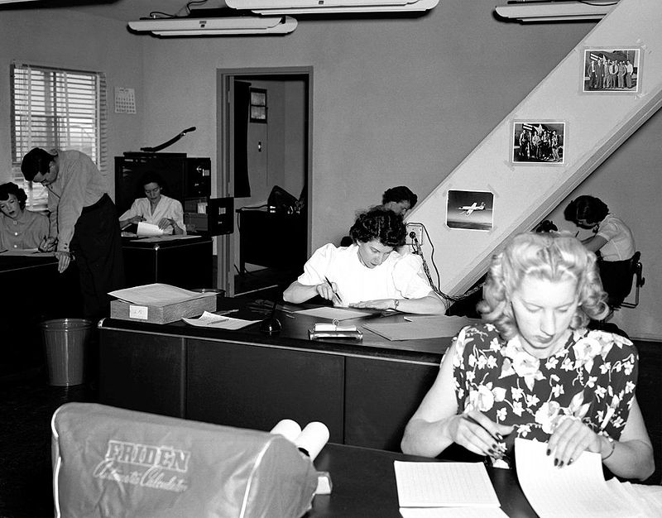
When computers were people
Until the widespread availability of electric computers in the middle of the last century, large teams of ‘human computers’ were used to solve repetitive calculation problems. A Computer was a job title like Secretary or Postman.
Human computers were used to solve problems in astronomy, naval navigation and for military artillery.
During WW2 when there was huge demand for human computers, most of them were women and, as a result, it was these same women who then went on to become the first programmers of electric computers after the war.

Slide 3
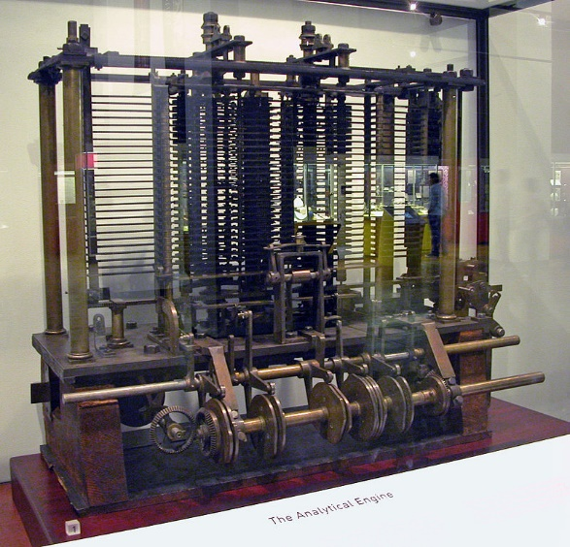
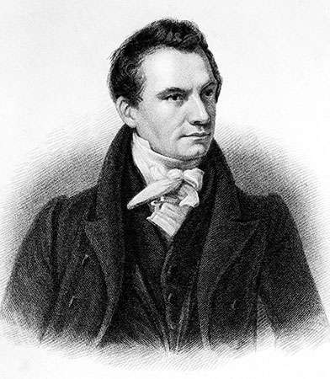
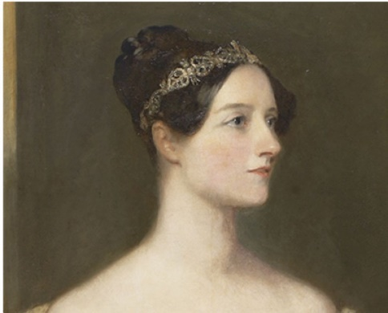
Mechanical Computing: a dream that never was
In 1837 an Englishman called Charles Babbage designed the first non-human, general purpose computer.
He had originally been commissioned by the British government to make a mechanical calculator for solving polynomial equations but struggled to manufacture it due to the inability of suppliers to affordably manufacture the required, complicated metal parts.
Frustrated by these delays he took to redesigning his machine and eventually hit on the idea, and design, for a ‘general purpose computer’ - one that could solve any mathematical problem. This is essentially the function of the computers that we have today.
His work was popularised and championed by the mathematician Lady Ada Lovelace whose descriptions of programs, or algorithms, for the Analytical Engine has seen her called ‘The first programmer’.
Sadly the Analytical Engine was never built from Babbage’s designs back in the 1800s. The British Government lost interest in funding Babbage’s work and Ada and Babbage were unable to secure any other reliable source of funding.
Imagine how different the world might have been today if the computing industry had started a hundred years earlier in the 1840s rather than the 1940s!
Babbage’s Mechanical Computer
Ada
Babbage

Slide 4
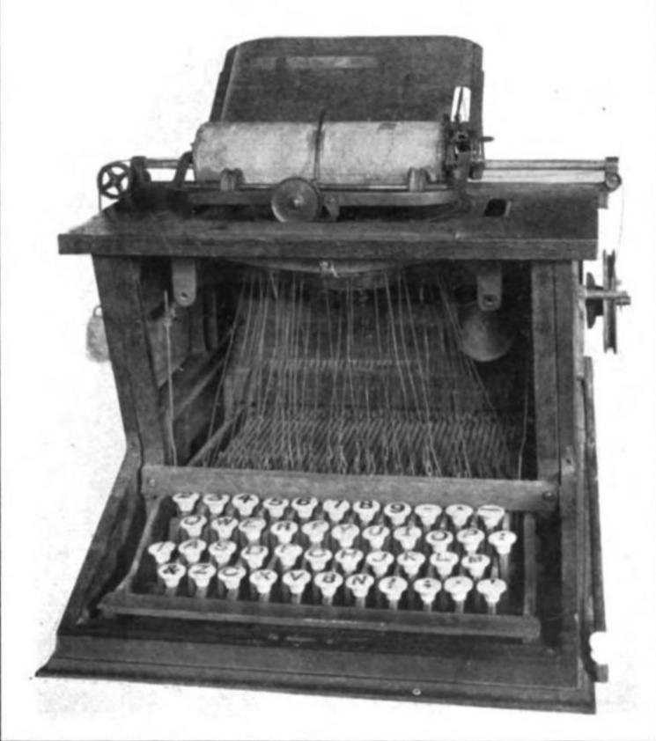
Machines move from the factory to the office and the shop
Modern personal computers were shaped by the office and shop floor machinery that preceded them.
The first commercially successful typewriter was produced in 1873 by the US civil war gun manufacturer Remington. It is this typewriter that had the QWERTY keyboard layout still used today.
The company NCR led the way in converting US retail businesses to automation with a large and aggressive sales strategy. It’s most famous product being the electric cash register and the company is still in business making the self-service checkouts used today.

Slide 5
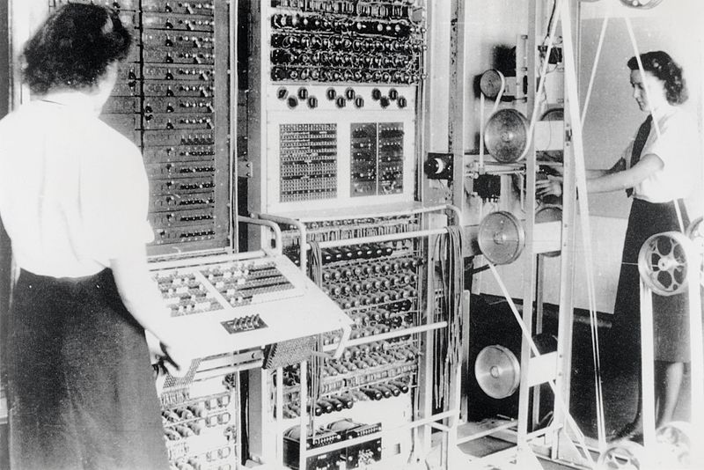
Born in War: The first electric computers
The demand for human computers was boomed massively during and leading up to WW2. Decrypting enemy codes and calculating artillery firing tables became a vital industry employing hundreds upon hundreds. Much of this work was classified for years after the war.
However these human computers could make mistakes and ultimately weren’t always fast enough for the real time needs of war.
Thus there was tremendous interest and investment in any project that could speed these processes up.
British Wartime computing projects included the Bombe and The Colossus, both at Bletchley Park. The most influential project however was the American’s ENIAC.

Slide 6
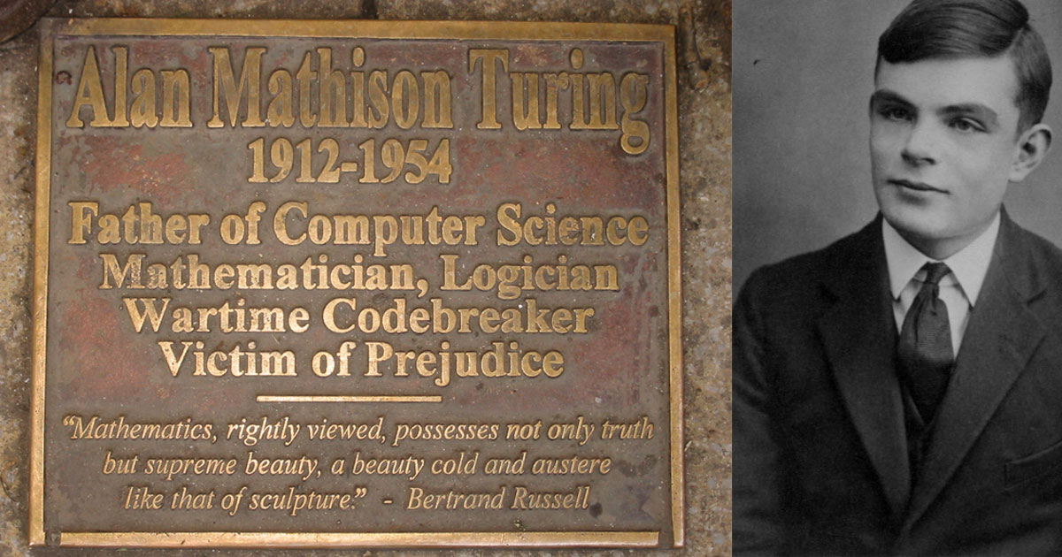
Alan Turing: Father of computer science
A child prodigy in mathematics, Turing was responsible for defining the concept of Turing Machines (a widely used theoretical description of a computer) and for describing the Turing Test for artificial intelligence.
During WW2 Turing was responsible for developing the British version of the Bombe computer (A Polish/British collaboration) that was able to crack the Nazi Enigma codes. It’s estimated that this work may have saved 14 million lives by shortening the war.
Despite being a war hero, Turing was arrested and prosecuted for being gay in 1952. He was then chemically castrated by the government.
In 1954 he died of Cyanide poisoning aged 41.

Slide 7
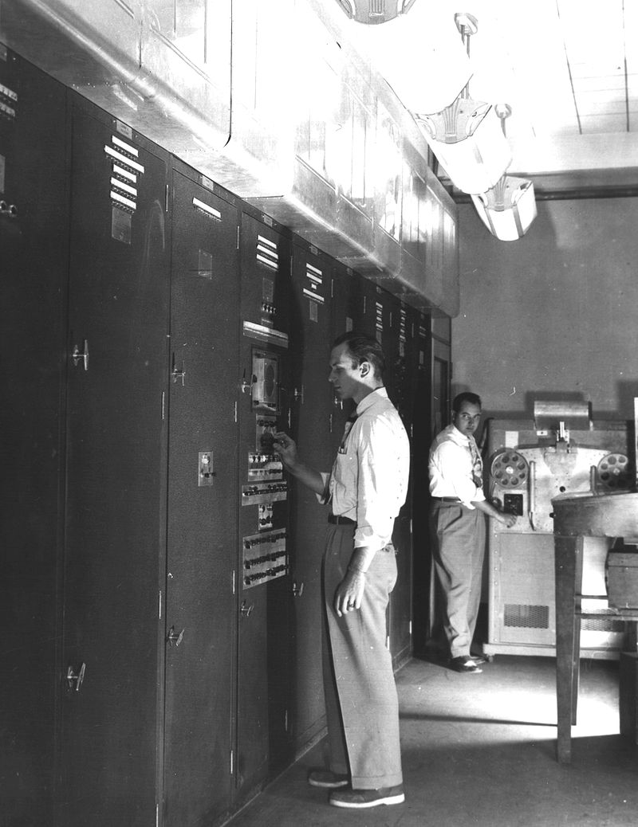
ENIAC & EDVAC
The ENIAC was the US Army’s solution to the problem of computing artillery tables.
The development of ENIAC caught the attention of the scientists working on the Manhattan Project to develop a nuclear bomb. In particular John von Neumann began working directly with its engineers on how to improve the design. The ENIAC’s first program was calculations on the feasibility of the atomic bomb.
The collaboration between von Neumann and the ENIAC’s engineers led to the design for the EDVAC which was the first computer design that could store its programs in the same memory that it stored the data it worked on.
Unlike other wartime computers this ‘von Neumann’ architecture was widely publicised and became the standard design for computers going forward.

Slide 8
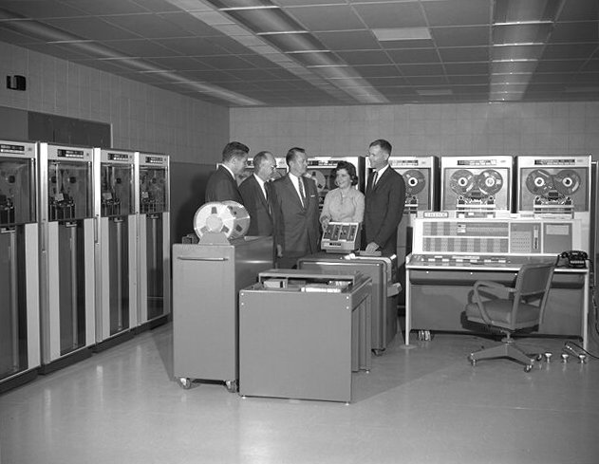
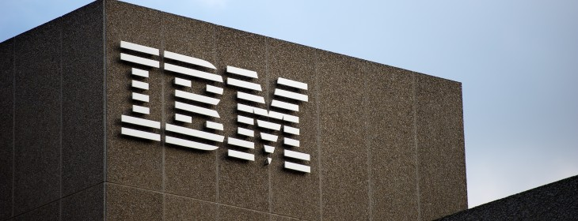
IBM
Much of the history of computer science is tied up with the history of IBM. It was the dominant corporation driving commercial computing from it’s founding in 1890 to help with the 1890 US census, up to the 1990s and the widespread adoption of the IBM compatible PC as the personal computing standard.
The driving personality in the early years of IBM was Thomas Watson Sr who had formerly been a top sales executive at NCR. His business strategies were enormously successful and widely adopted by other corporations.

Slide 9
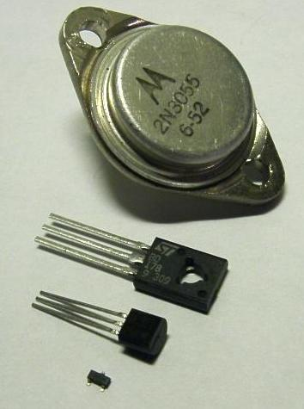
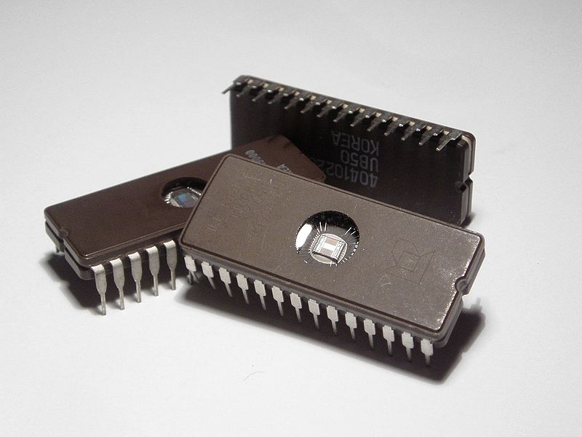
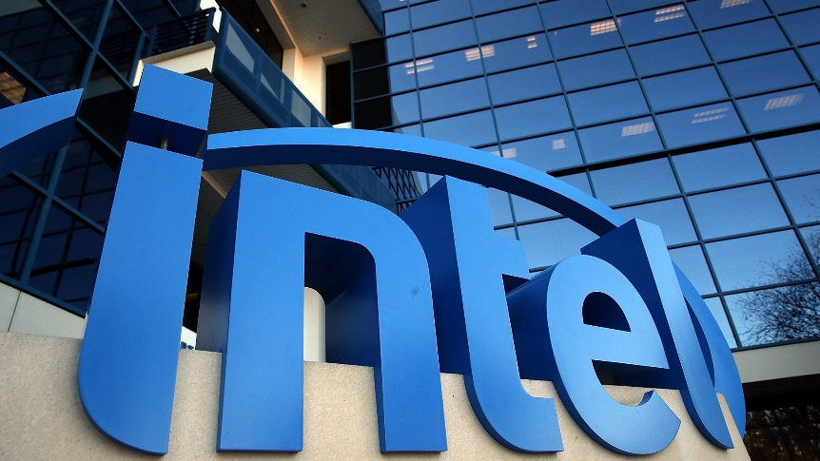
Transistors, microchips & miniaturisation
The invention of a practical transistor in the late 1940s enabled all kinds of electronics to get smaller including computers.
In the late 1950s two people simultaneously figured out how to cram multiple electronic components onto flat ‘wafers’ of semi-conductive material. This design became known as the integrated circuit and it was ideally suited to miniaturisation.
In the 1970s the company Intel was founded to manufacture these Integrated circuits and became the market leader, driving ever smaller computer chips.

Slide 10
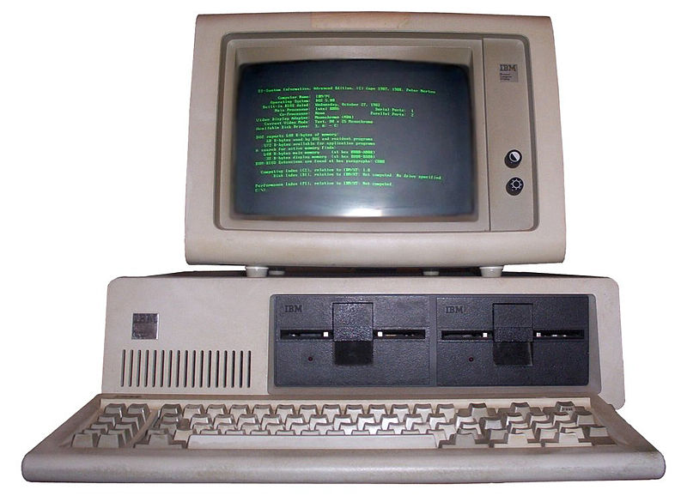
Computers get personal
For a long time computers were enormous room-sized machines that could only be afforded by large companies or institutions like universities.
Individuals that wanted to use a computer would often have to book time on one in advance, submit the program they wanted to run to an operator (perhaps as a stack of punch cards) and then wait for any results. This was not ideal – especially for debugging.
So there was demand for a ‘personal computer’ and eventually the advances in miniaturising electronics made it possible and affordable.
It fell to IBM at the height of it’s commercial power to make a standard – the IBM compatible PC – that would start an industry.

Slide 11
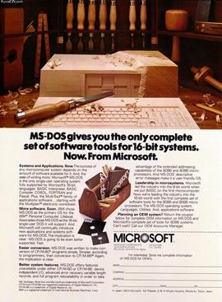
Software overtakes hardware
For the first era in the history of computer science almost all of the money was in developing hardware. The computers themselves.
The dawn of the PC changed all that, all the new PC owners had a huge appetite for software and were prepared to pay for it.
Microsoft was the first and main beneficiary of this new industry after IBM chose Microsoft’s Disk Operating System as it’s default software. The founder of Microsoft; Bill Gates became the richest man in the world.

Slide 12
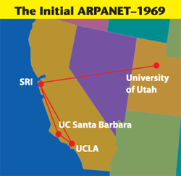



The information superhighway
The internet began as a project called ARPANET funded by the US Advanced Research Projects Agency. It was designed to be a communications network that could survive a nuclear war.
The network really took off after the invention in 1989 of the world wide web by CERN scientist Tim Berners-Lee. The web made it easy to connect and share information through hyperlinks.
Google became the dominant search engine for the web and from there became the top internet company in the world.
When it began the web was far too slow for streaming videos but now videos make up nearly 80% of internet traffic.

Slide 13
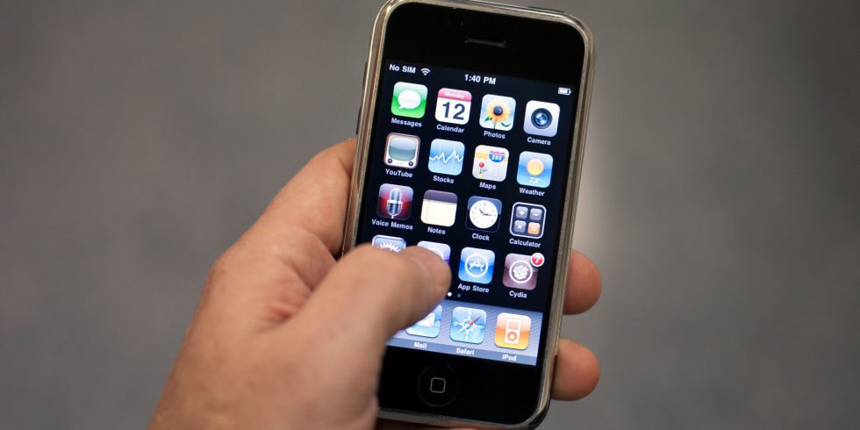
Computing goes mobile
The release of the iPhone in 2007 was the start of a new era of computing. Electronics had now been miniaturised so effectively that we could fit computing power that used to fill rooms into our pockets.
Wireless internet connections were also crucial to the success of mobile computing. Streaming videos on a train or a bus has become commonplace.
The size of the mobile computing industry is enormous and ten years later we have already begun to see the technologies refined in mobile phones find new uses elsewhere such as Virtual Reality and Smart Watches.

Slide 14
THE END

